Slide 1
Seeing the Big Picture:
Visualizing Bible Data
Sean Boisen, Faithlife
BibleTech 2015
5/2/2015
Twitter: @seanboisen, @biblevis; #bibledata, #bibletech
Slides: http://SeanBoisen.com/talks/2015/biblevis
http://biblevis.com
Notes:
Goals
Show the breadth of Bible data at Faithlife
Give some examples of the kinds of visualizations these data support
Drayton gave a number of examples in his previous talk, and several others have as well
Show how Bible visualizations can provide insight that is otherwise hard to obtain
Look at a variety of Bible visualizations
Not all come from Faithlife, and I get no credit for the ones that do

Slide 2
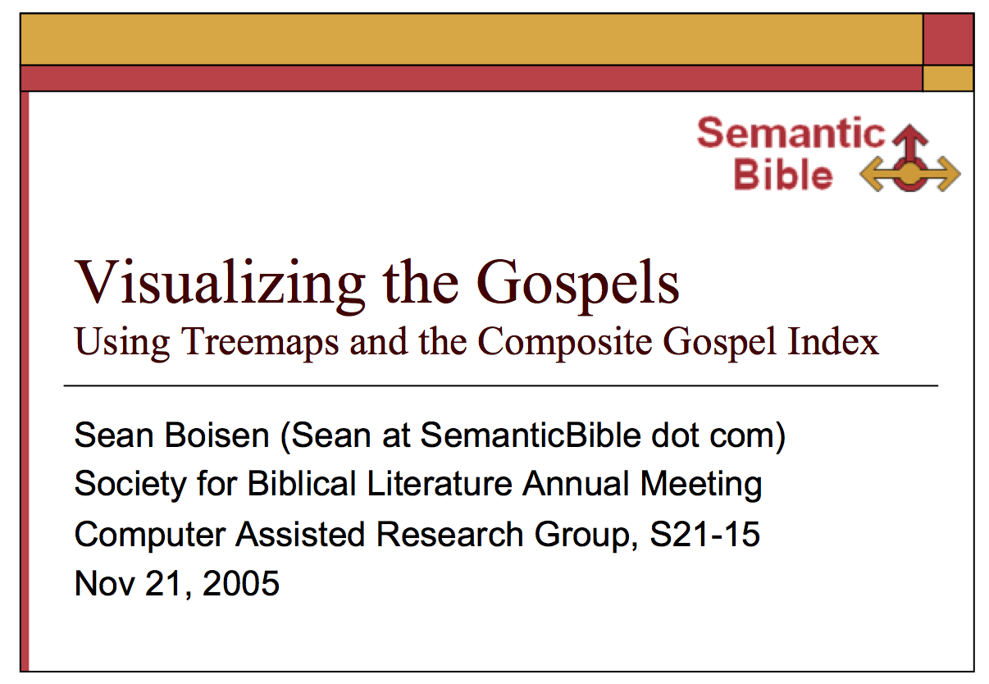
Looking Back …
Notes:
Something of an anniversary: 10 years ago, SBL presentation on Visualizing the Gospels,
Research scientist masquerading as a biblical scholar
met Rick Brannan, got introduced to Logos Bible Software
Wound up turning my hobby into a career change
So I’m still working on the same project: helping people see a bigger picture of the Bible

Slide 3
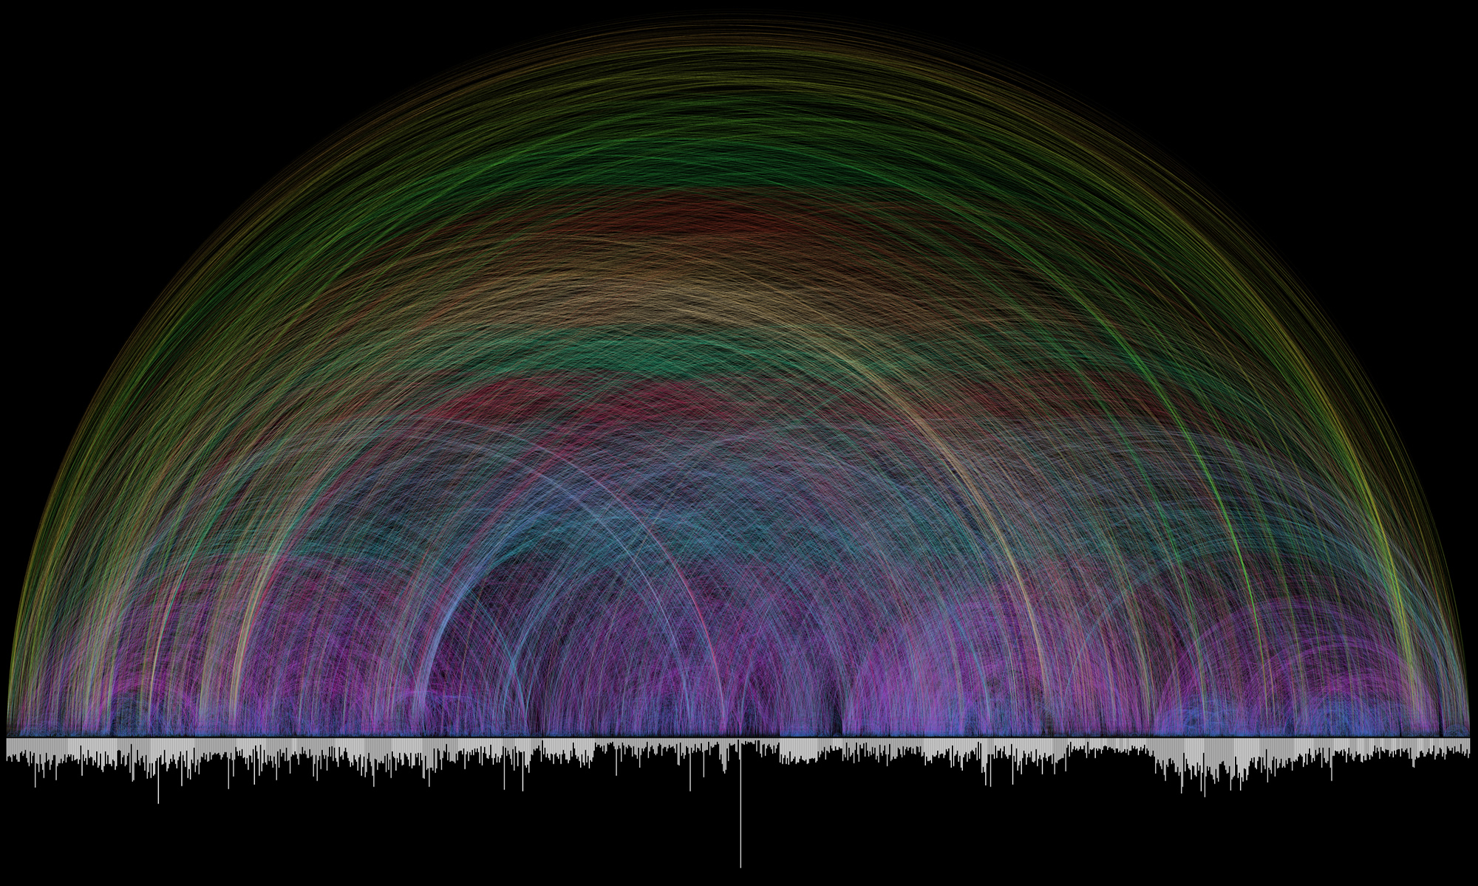
Seeing the Big Picture
“Instead we set our sights on the other end of the spectrum –- something more beautiful than functional.”
Notes:
Perhaps the most famous Bible visualization of the last decade
Seen it?
2007, by Chris Harrison, Christoph Römhild, a Lutheran Pastor
64k cross references
Bar along bottom represents chapters: Books alternate between white and gray
Descending line indicates number of verses: Ps 119 is the outlier with 176 verses
Color encodes distance
“Instead we set our sights on the other end of the spectrum –- something more beautiful than functional.”

Slide 4
Understanding the Big Picture
Information visualization vs. art
What kind of information?
Visualization as storytelling
One size doesn’t fit all
Notes:
Not wanting to pick on Chris Harrison, but nicely illustrations the tension between visualization as art vs. visualization for understanding
The purpose of Information visualization: see overall patterns amplifies cognition
Overall patterns in the data
let’s ask the bigger question, what does this let me see?
Lots of info vis systems:
Some allow open-ended exploration
Sometimes it’s more directive, like storytelling

Slide 5
Bible Data at Faithlife
Historical Knowledge
Events
People
Things
Artifacts
Places
Concepts
Timeline Events
Logos Controlled Vocabulary
Biographies
Cultural Concepts
Saints
Preaching Themes
Biblical Knowledge
Cross-References
Biblical language & linguistics
Reference Content
Ancient Literature
Case Frames
Prop. Labels
Genre
Culture
Bible Dictionaries
Senses
Syntax
Discourse
Pericopes
Grammars
Commentaries
Bible text: words, lemmas, morph
Systematic Theo.
Aligned translations
Lexicons
Notes:
We’ve created a lot of data at Faithlife, much of it by the Content Innovation team
Walk through a big picture of some of this data
Didn’t manage to fit everything
Increasingly we’re creating novel scholarly content that doesn’t exist anywhere else
Another whole cluster of zoomable maps, infographics, 3-d reconstruction of Jerusalem,
How do we see the big picture?
Long history and culture of the micro-view in biblical studies
Take advantage of much higher visual bandwidth (and appeal)

Slide 6
The Process
Curate data
Display
Search
Visualize
Notes:
We collect some new data set
Figure out how to display it to users
Add the ability to search across a whole resource or corpus in comprehensive and complex ways
Sometimes we complete the whole cycle quickly (Psalms Explorer)
For other cases, we’re still working to show the big picture

Slide 7
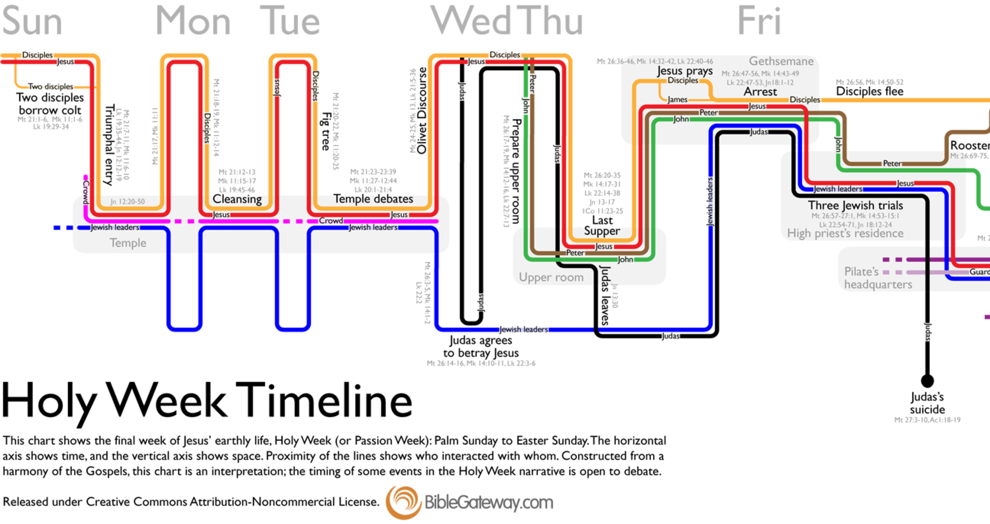
Notes:
So let’s look at a couple of examples
Visualization by the group at Bible Gateway
Combines time, individuals, activities, grouping
Not really a data visualization, more artistic, but it really does help with seeing the Big Picture
Visually engaging, colorful, understandable without much explanation, draws you into the details

Slide 8
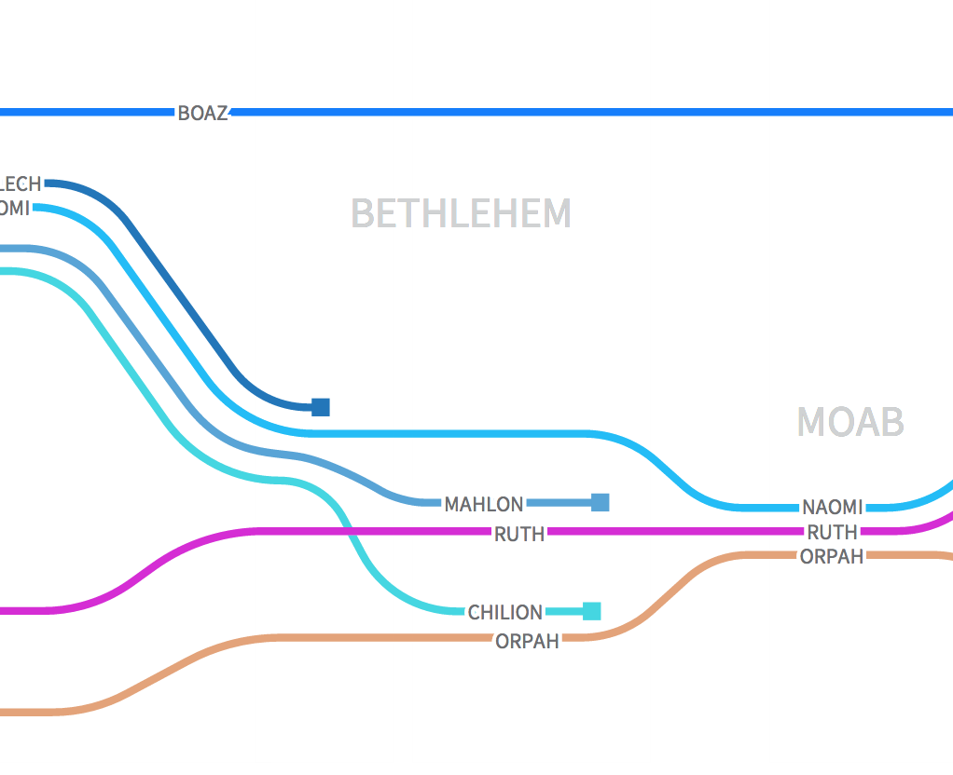
Narrative Character Maps (Logos)
Relationships over time
Curated art
Interactive
(Live demo in Logos)
Notes:
Added interactivity
More information on events, individuals
Step through the events
Zoomable

Slide 9
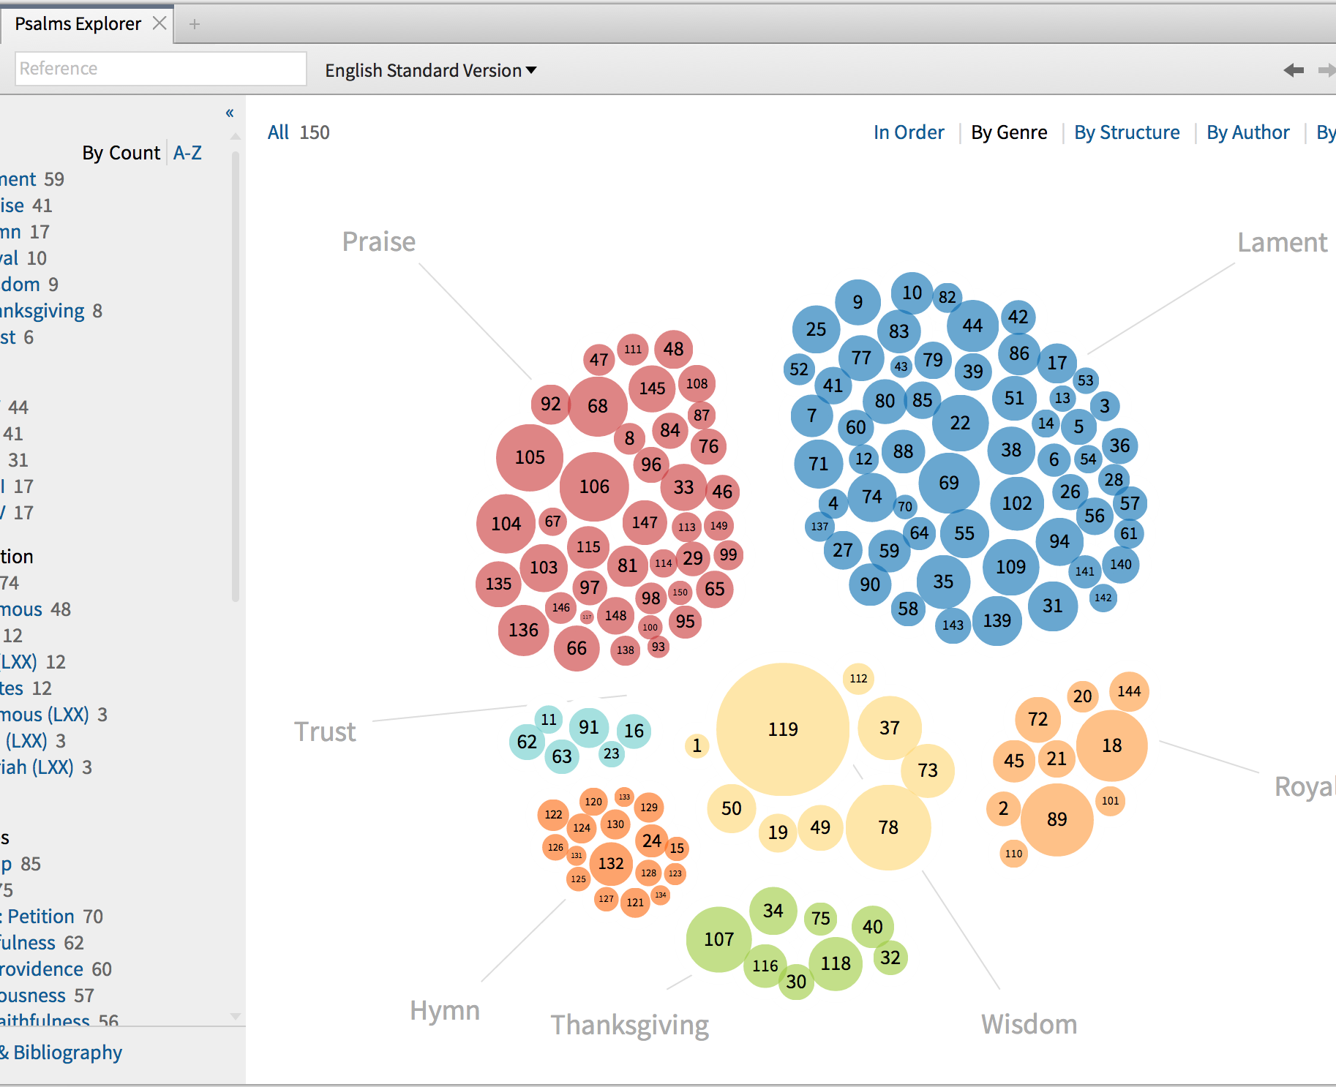
Psalms Explorer (Logos)
Shneiderman’s Mantra
  Overview first
  Zoom and filter
  Details on demand
(Live demo in Logos)
Notes:
Ben Shneiderman at UMd, HCI
His mantra for information visualizations
Categories, groupings
Genre, Book, Attribution, Themes, Structure, others
Bubbles sized by number of verses
Faceted browsing paradigm dynamically provides more information as you filter
Powerful paradigm for data exploration
Clicking through gives you the text of the psalm with additional annotations
No particular story or point of view: lets you explore the data

Slide 10
People and Places in Narrative
Enabling data
  Bible Knowledgebase
  Referent mentions (names, pronouns, descriptions)
  Pericopes
Big picture: how are mentions distributed throughout the text?
Notes:
Consider some addition visualizations we might build
Not curating the art here
Only valuable for narrative, and probably only some narratives: data exploration
You’d want hyperlinks to people, pericope text, mention highlights

Slide 11
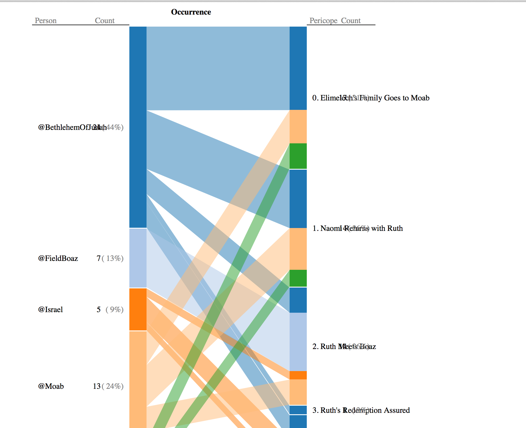
Places in Ruth
How are different places mentioned throughout Ruth?
(Live Demo)
Notes:
Places down the left side, counted by mentions, color-coded
Six pericopes down the right side
Colored bars across the middle indicate correlations
You can focus on either side to select that data and its correlations
Bethlehem is mentioned in all pericopes except the last one
Field of Boaz only in the story where Ruth meets Boaz
Judah only mentioned in the first two pericopes
Descendants of Ruth and Boaz
Imagine interactivity with details on demand, and navigation to Place records or pericope text

Slide 12
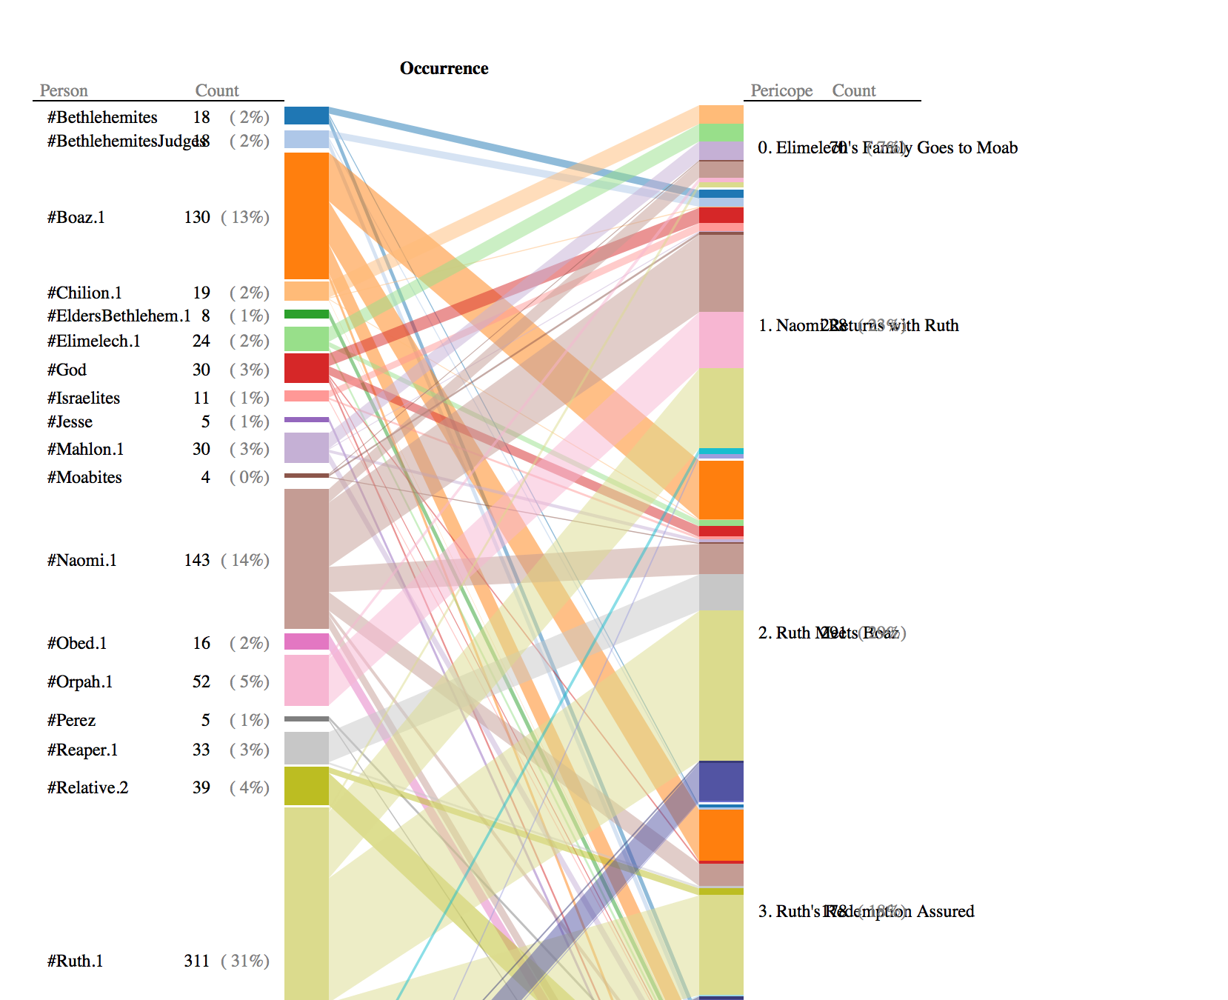
People in Ruth
How are different people mentioned throughout Ruth?
(Live Demo)
Notes:
Who are the major players?
Where do they enter and exit?
How are they mentioned together?
Big picture: much more information available , more opportunity for exploration

Slide 13
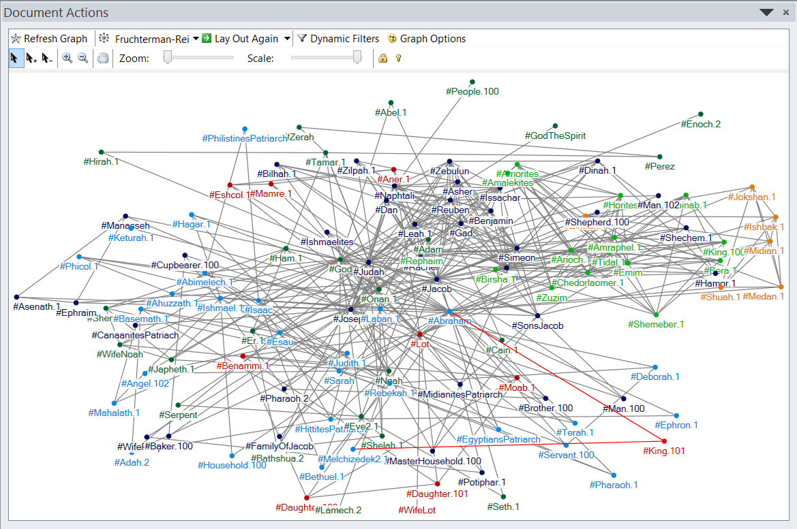
Social Networks for Biblical People
Notes:
“Related” if co-mentioned as participants in an event.
Data matters here:
Not every name, but those that are significant participants in an event
Counting by event co-occurrence makes more meaningful connections than chapters or other units: following story relationships
Automated algorithm here is grouping and styling by color (NodeXL)
Still too much noise

Slide 14
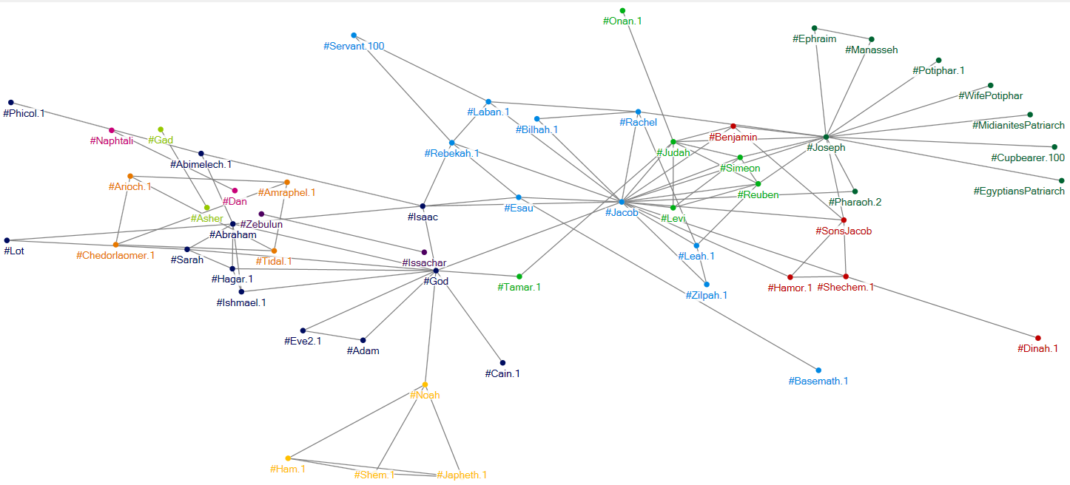
Social Networks for Biblical People (2)
Notes:
Slightly better version where I’ve filtered out pairs that only occur in one event

Slide 15
Exploring Senses and Pericopes
Enabling data
  Word-level data on lexical semantics
  Pericope structure
Big picture
  Given <document>, what are the most important terms?
  Given <term>, what are the most important documents?
Notes:
Bible Sense Lexicon
Reciprocal notion
"terms" rather than items
"documents" rather than units
“relevance engineering”

Slide 16
Strawman: Count
Counts are typically dominated by low-content items that occur everywhere
Frequency ≠ significance
Frequency ≠ distinctiveness
Notes:
More terms means more important, right?

Slide 17
Weight by Distribution
Standard approach: tf.idf
  tf = term frequency in a given document
  idf = inverse document frequency: distribution of term across all documents
  Intuitions:
    high tf means frequent in this document
    low idf means frequent in corpus
    high tf.idf means distinctive for this document
Notes:
Idf is 1/df(term), so a low number means a common term

Slide 18
Data: Senses by Pericope
 | t1 | t2 | t3 | tn
d1 | 1 | 0 | 0 | 0
d2 | 0 | 3 | 1 | 0
d3 | 2 | 0 | 0 | 0
dn | 2 | 0 | 0 | 1
Table of pericopes by senses
D (# of pericopes) = 3424
# of senses = 15k
Very sparse data
  mean = 49 distinct senses per pericope
Notes:
Use case: given document, what are the most distinctive terms?
Upwards of 50M cells, far less than 1% have values

Slide 19
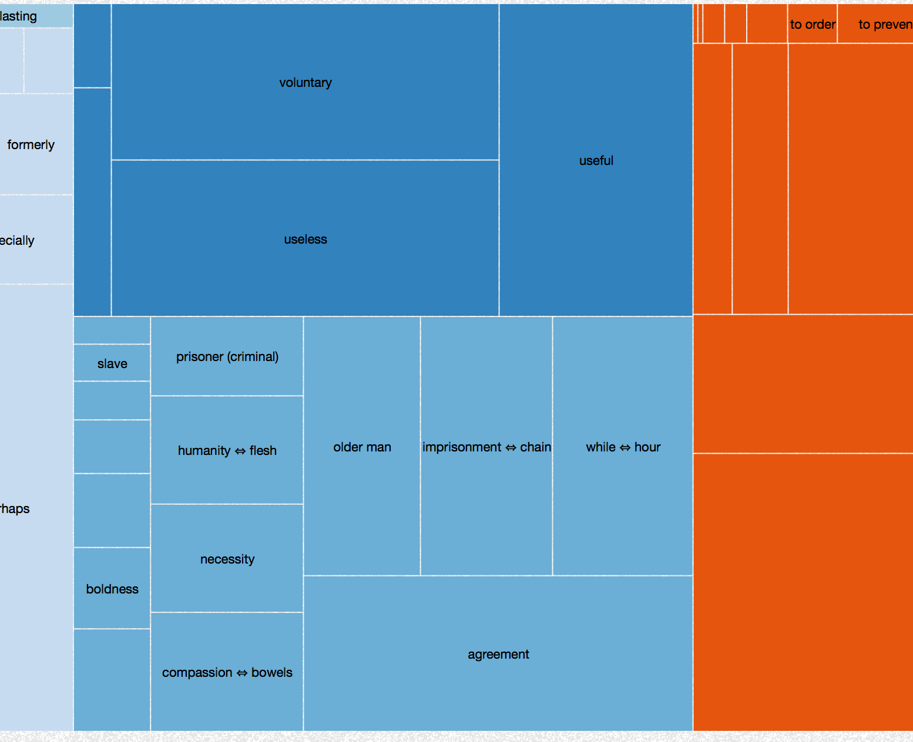
From Document to Term
Which senses are most distinctive for a pericope?
(Demo: Rom 5:12-21)
Notes:
Starting from larger units and working down to smaller ones
Several senses in the same general area as “sin”

Slide 20
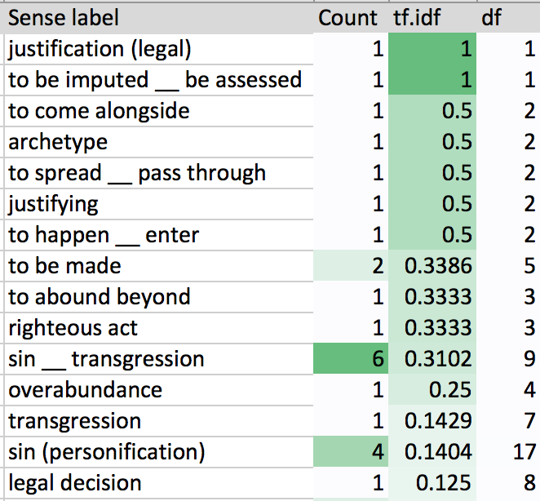
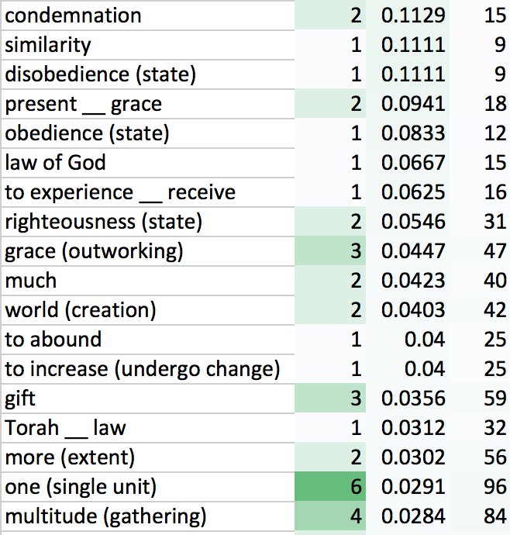
Counts vs. Weights (Rom 5:12-21)
Notes:
There are 55 senses in this pericope: only showing the top 33
Compare counting, tf.idf, and frequency throughout the corpus (number of pericopes in which this sense occurs)’
Color gradients by columns to show the maximums
“sin (personification)” occurs in 17 pericopes

Slide 21
From Term to Document
Dead to Sin, Alive to God (Rom 6:1__14) | 0.1881
Law Cannot Save from Sin (Rom 7:13__25) | 0.1811
Sin and the Child of God (1 John 3:4__9) | 0.1642
Sin's Advantage in the Law (Rom 7:7__12) | 0.1535
From Slaves of Sin to Slaves of God (Rom 6:15__23) | 0.1535
Free from Indwelling Sin (Rom 8:1__11) | 0.1404
Death in Adam, Life in Christ (Rom 5:12__21) | 0.1404
Be Reconciled to God (2 Cor 5:12__21) | 0.0996
Our Final Victory (1 Cor 15:50__58) | 0.0996
Fellowship with Him and One Another (1 John 1:5__2:2) | 0.0588
Purpose of the Law (Gal 3:19__25) | 0.0588
Be Faithful (Heb 3:7__15) | 0.0588
The Discipline of God (Heb 12:3__11) | 0.0588
No Return to the Law (Gal 2:11__21) | 0.0588
Christ's Suffering and Ours (1 Pet 3:18__4:6) | 0.0588
All Have Sinned (Rom 3:9__20) | 0.0588
Greatness of Christ's Sacrifice (Heb 9:23__28) | 0.0588
Pericopes with highest tf.idf for “sin (personification)”
Notes:
Working from smaller units up to larger ones and exploring the corpus

Slide 22
Generalizing the Approach
Lemma | ×
Morph |  | Verse
Sense |  | Pericope
Entity mention |  | Event
Phrase |  | Chapter
Cultural concept |  | Book
Discourse feature
Propositional category
Notes:
Shown correlations between senses and pericopes
Can do the same kind of correlation between other terms and units
Iterative process going from documents to terms, and terms to documents
I’m interested in building interactive systems that connect these data and allows you to explore these relationships further
Different units require different views
Hierarchy supports a zoomable view: start with
Ideally longer books would have additional structure to support visualization

Slide 23
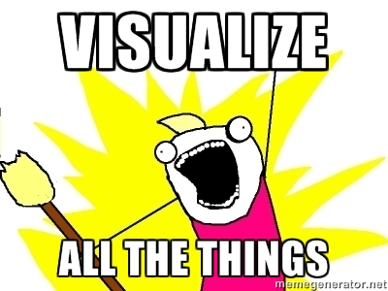
Conclusion
The greatest value of a picture is when it forces us to notice what we never expected to see.
―John Tukey
Notes:
We can’t always expect users to know what to look for
Our ultimate goal is to not to accumulate data, but to create insight
And so …

Slide 24
Contact
Email: my first name at faithlife.com
Faithlife.com: @seanb
Personal sites: SeanBoisen.com, BibleVis.com
Twitter: @SeanBoisen, @BibleVis, #BibleData
Notes:
Here’s some contact information if you’d like to follow up on these ideas
Started blogging about Bible visualizations at BibleVis.com, Twitter account for that activity
Any questions?

