Slide 1
Automatically Learning Topical Content
Sean Boisen
Senior Information Architect,
Director of Content Innovation
WWU Tech Talk
May 6, 2021
Notes:
I’ve given dozens of presentations over the several decades of my career as a technologist, but I believe this is my first time doing a presentation on Zoom
COVID has given us all a new set of challenges
Chat window open: ask at any time, question at the end

Slide 2

Content Innovation at Faithlife
CI is about data
  Linguistic annotation
  Knowledge management
  Data management
  Media, Atlas, more
Smarter, faster, cheaper ...
The best way to predict the future is to invent it—Alan Kay
Notes:
Logos Bible Software is the primary product Faithlife sells
Integrated digital library, offer more than 150k books in our format
Wide variety of subjects, including subject-oriented reference works, like specialized dictionaries and encyclopedias
My role at Faithlife:
i lead the Content Innovation team, which organizes information to support Logos
Mix of biblical studies, linguistics, programing, knowledge organization and management, and curation
We curate data, automatically when we can, manually when we must
Prior to Faithlife, I had a 20-year career in Natural Language Processing with Raytheon/BBN Technologies

Slide 3
Outline
Describe the Logos Controlled Vocabulary (LCV) and corpus
Topical content use cases
Technical challenges
Automatic discovery of topical connections
Notes:
LCV: we have a unique data resource of topic-aligned content
This is very much work in progress, not a finished result or product

Slide 4
The Logos Controlled Vocabulary (LCV)
35k concepts from the domain of biblical studies.
Publisher content issues
  Ambiguity
  Homographs
  Synonyms
  Spelling variations
Provides semantic organization.
A corpus of articles manually aligned with the LCV.
> 450k articles from 100s of dictionaries, encyclopedias, glossaries, journals, etc.
Focus on subject-oriented content.
Sources are largely independent.
Controlled vocabularies provide a way to organize knowledge for subsequent retrieval. -- Controlled vocabulary - Wikipedia
Notes:
By concept, i mean an abstraction for a semantic notion as described in reference content.
One LCV record per unique concept.
The LCV corpus is a unique data resource, approaching 100M words of topic-aligned content

Slide 5
LCV Example: %Jerusalem_Place
Preferred label | Jerusalem
Alternate labels | City of God; Holy City; (others)
Description | The capital city of biblical Israel, and later of the southern kingdom of Judah. The central location for Israel’s self-understanding of life under God.
Type | Place
Name? | Yes
Biblical? | Yes
> 200 aligned articles.
Narrower:
%Ariel_Place, %CityOfChaos_Place,
%HolyCity_Place
Relationships to entities in the biblical text.
Notes:
(Walk through the attributes)
We also have localizations of much of this data (description in Spanish, German, etc. Currently shipping base products for 8 languages)
Many other attributes outside the scope of this presentation
At the lowest level, a collection of MySQL tables, accessed through the Django framework, with internal tools for editing, scripting for updates and extraction, shipping as JSON, etc. Shipped as part of Logos Bible Software, supporting several different features.

Slide 6
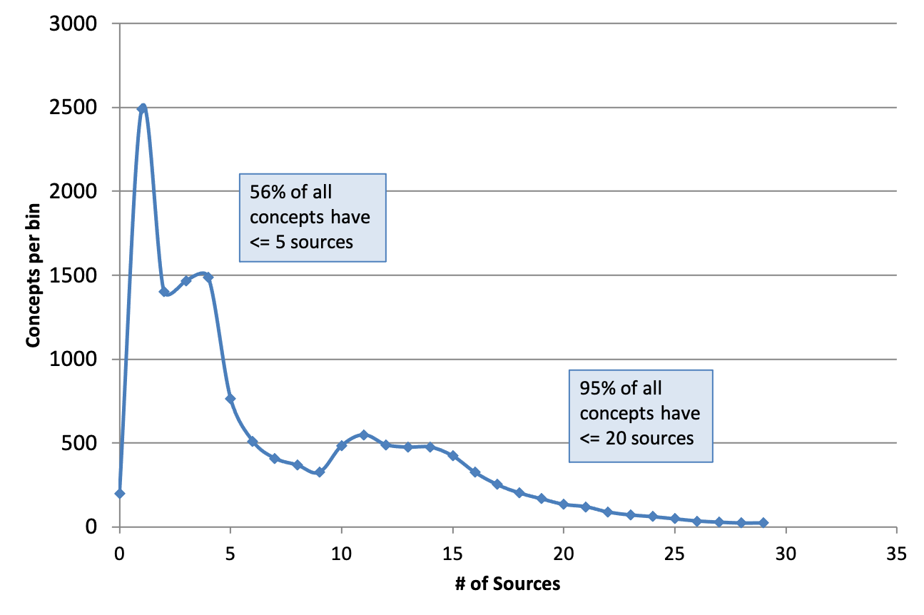
Article Sources for Concepts (2013)
See Zipf's law - Wikipedia for information on power law distributions in language.
“Uncommon”
“Common”
Notes:
Old chart, so the numbers are obsolete, but I expect the scale and relationships still hold.
Typical power law distribution

Slide 7
Why Topical Analysis?
Primary way to explore texts
Facilitate discovery
Incentivize large libraries
Notes:
Exploring texts by topic or subject
You’re reading and see an unfamiliar term or phrase and you want to know more about it
The success of Wikipedia is testimony to the importance of exploring knowledge by organized subjects
We have a feature in Logos called Factbook that performs a similar function as the starting point for learning about a subject
But not primarily prose, and not crowd-sources, but presented, mined and aggregated from the user’s library of content and our specialized knowledge bases.
Facilitate discovery:
An interesting characteristic of the growth of Logos Bible Software over the last almost 30 years.
The original problem: how do we get more books into our platform?
The new problem: how do I find information in such a large space?
In that sense, we’re in the same business as Google, but on a vastly smaller scale, and in a particular subject domain.
Incentivize large libraries
Our business model substantially depends on people buying our software and enhancing it with lots of books.
The more books you own, the more content we can organize for you.

Slide 8
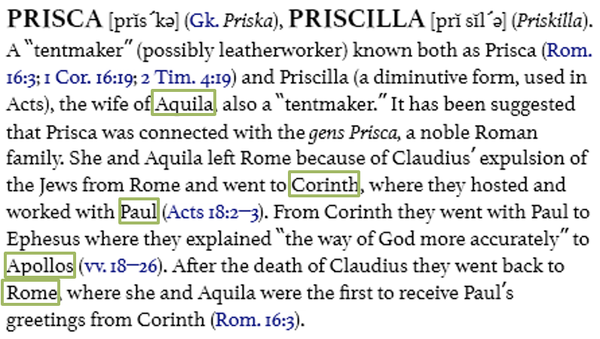
Term → Concept Associations
Terms that match other concepts may signal relevant relationships.
We can pool the terms across multiple articles for the same concept to “vote” on these associations.
These can be weighted by comparing counts for this concept to the whole corpus
(See tf–idf - Wikipedia for more.)
Notes:
Don’t have time to go into the details here, but the insight is:
terms that are more strongly associated with this article compared to other articles are stronger indicators of the content of this article. We infer that also makes them better indicators of relationships with other articles.
Other high-frequency terms that are associated this this concept but don’t occur in this article: husband, church, Christian, couple
The challenges:
Identifying terms that map to an LCV concept
accumulating enough evidence to allow the most significant terms to emerge

Slide 9
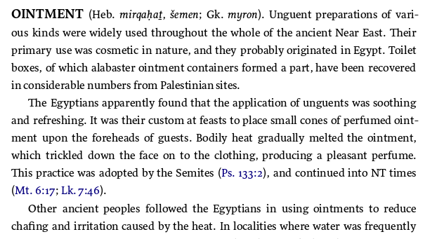
Reference → Concept Associations
Content about Biblical subjects typically includes references
Estimate the association between a concept and references by aggregating counts across all content (voting scheme)
Provide a ranked list of references to explore for a concept
Notes:
There’s an aspect of this analysis that’s unique to the domain of biblical studies: in-line Bible references. These are really specialized terms.
Word repetition is common: reference repetition is relatively rare
Again, not just frequency of association, but distinctiveness (tf-idf)
Again, these estimates should get better as more content is added

Slide 10
Reference → Concept Associations (2)
Mk 14:3 | 19
Lk 23:56 | 16
Es 2:12 | 14
Is 1:6 | 13
Ps 133:2 | 13
...
Compare reference vectors to find concepts with similar references.
Find other concepts that have Mk 14:3 as a reference: %spikenard, %flask, %alabaster, $spice, %BethanyOfJudith_Place, etc.
Score them against the other ointment references to determine the strength of association.
Top References for %ointment

Slide 11
Application
Automatic hyperlinking of article text to other concepts
See Also link generation and ranking
Automating the ongoing curation of new article content
Quality control: concepts with “fuzzy” associations may have bad training data.
Building the graph of concept associations for additional analysis.
The Holy Grail: recommend other content to read based on a user’s current activity.

Slide 12
Future Work
Continue growing the corpus.
Automate the annotation of article content with LCV hyperlinks.
Learning phrases (not just terms) that refer to concepts (collocation analysis).
Questions?

Slide 13
Other Points
Tokenization is hard, even with rich text.
Reference overlap vs token identity

